Slide 1
Operating System
Tim Pengampu MK Sistem Operasi
Universitas Dian Nuswantoro

Slide 2
Process Scheduling : CPU Scheduler
The CPU scheduler selects from among the processes in ready queue, and allocates the a CPU core to one of them
Queue may be ordered in various ways
CPU scheduling decisions may take place when a process:
1. Switches from running to waiting state
2. Switches from running to ready state
3. Switches from waiting to ready
4. Terminates
Scheduling under 1 and 4 is nonpreemptive
All other scheduling is preemptive
Consider access to shared data
Consider preemption while in kernel mode
Consider interrupts occurring during crucial OS activities

Slide 3
Scheduling Criteria
CPU utilization – keep the CPU as busy as possible
Throughput – # of processes that complete their execution per time unit
Turnaround time – amount of time to execute a particular process
Waiting time – amount of time a process has been waiting in the ready queue
Response time – amount of time it takes from when a request was submitted until the first response is produced, not output (for time-sharing environment)

Slide 4
Scheduling Algorithm Optimization Criteria
Max CPU utilization
Max throughput
Min turnaround time
Min waiting time
Min response time

Slide 5
Types of scheduling
Long-term : To add to the pool of processes to be executed.
Medium-term : To add to the number of processes that are in the main memory.
Short-term : Which of the available processes will be executed by a processor?
IO scheduling: To decide which process’s pending IO request shall be handled by an available IO device.

Slide 6
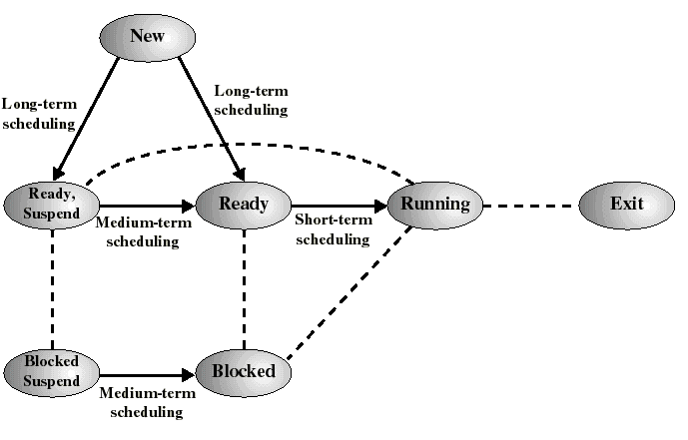
Classification of Scheduling Activity
Long-term: which process to admit
Medium-term: which process to swap in or out
Short-term: which ready process to execute next

Slide 7
Scheduling Algorithm
Non-Pre-emptive
FIFO (First In First Out) a.k.a. FCFS (First Come First Serve)
SJF (Shortest Job First)
HRN (Highest Ratio Next)
MFQ (Multiple Feedback Queues)
Pre-emptive
RR (Round Robin)
PSJF (Pre-emptive Shortest Job First)
SRF (Shortest Remaining First)
PS (Priority Scheduling)
GS (Guaranteed Scheduling)

Slide 8
First-Come, First-Served (FCFS) Scheduling a.k.a FIFO
Process Burst Time
P₁ 24
P₂ 3
P₃ 3
Suppose that the processes arrive in the order: P₁ , P₂ , P₃ The Gantt Chart for the schedule is:
Waiting time for P₁ = 0; P₂ = 24; P₃ = 27
Average waiting time: (0 + 24 + 27)/3 = 17

Slide 9
FCFS Scheduling (Cont.)
Suppose that the processes arrive in the order:
P₂ , P₃ , P₁
The Gantt chart for the schedule is:
Waiting time for P₁ = 6; P₂ = 0; P₃ = 3
Average waiting time: (6 + 0 + 3)/3 = 3
Much better than previous case
Convoy effect - short process behind long process
Consider one CPU-bound and many I/O-bound processes

Slide 10
Shortest-Job-First (SJF) Scheduling
Associate with each process the length of its next CPU burst
Use these lengths to schedule the process with the shortest time
SJF is optimal – gives minimum average waiting time for a given set of processes
The difficulty is knowing the length of the next CPU request
Could ask the user

Slide 11
Example of SJF (Non-Preemptive)
ProcessArrival e Burst Time
P₁ 0.0 6
P₂ 2.0 8
P₃ 4.0 7
P₄ 5.0 3
SJF scheduling chart
Average waiting time = (3 + 16 + 9 + 0) / 4 = 7

Slide 12
Example of Preemptive SJF
Process Arrival Time Burst Time
P₁ 0.0 7
P₂ 2.0 4
P₃ 4.0 1
P₄ 5.0 4
Average waiting time = (9 + 1 + 0 +2)/4 = 3
P₁
P₂
P₃
P₂
P₄
P₁
0
2
4
5
7
11
16

Slide 13
Example of Shortest-remaining-time-first
Now we add the concepts of varying arrival times and preemption to the analysis
ProcessA arri Arrival TimeT Burst Time
P₁ 0 8
P₂ 1 4
P₃ 2 9
P₄ 3 5
Preemptive SJF Gantt Chart
Average waiting time = [(10-1)+(1-1)+(17-2)+5-3)]/4 = 26/4 = 6.5 msec

Slide 14
Round Robin (RR)
Each process gets a small unit of CPU time (time quantum q), usually 10-100 milliseconds. After this time has elapsed, the process is preempted and added to the end of the ready queue.
If there are n processes in the ready queue and the time quantum is q, then each process gets 1/n of the CPU time in chunks of at most q time units at once. No process waits more than (n-1)q time units.
Timer interrupts every quantum to schedule next process
Performance
q large ⇒ FIFO
q small ⇒ q must be large with respect to context switch, otherwise overhead is too high

Slide 15
Example of RR with Time Quantum = 4
Process Burst Time
P₁ 24
P₂ 3
P₃ 3
The Gantt chart is:
Typically, higher average turnaround than SJF, but better response
q should be large compared to context switch time
q usually 10ms to 100ms, context switch < 10 usec

Slide 16
Priority Scheduling
A priority number (integer) is associated with each process
The CPU is allocated to the process with the highest priority (smallest integer ≡ highest priority)
Preemptive
Nonpreemptive
SJF is priority scheduling where priority is the inverse of predicted next CPU burst time
Problem ≡ Starvation – low priority processes may never execute
Solution ≡ Aging – as time progresses increase the priority of the process

Slide 17
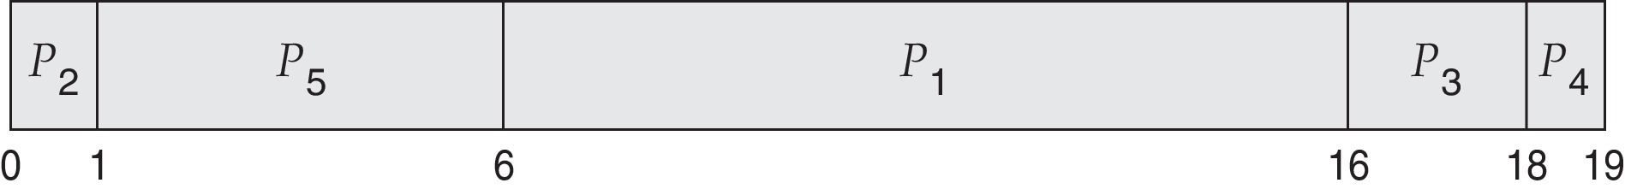
Example of Priority Scheduling
ProcessA a Burst TimeT Priority
P₁ 10 3
P₂ 1 1
P₃ 2 4
P₄ 1 5
P₅ 5 2
Priority scheduling Gantt Chart
Average waiting time = 8.2 msec

Slide 18
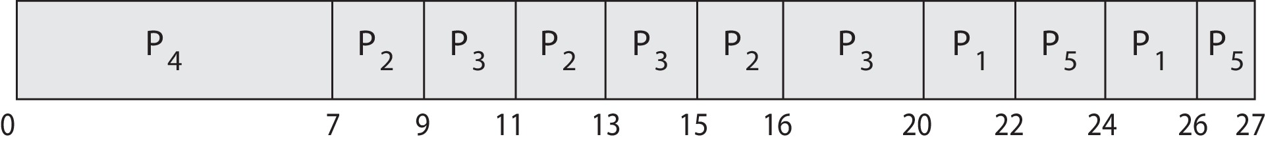
Priority Scheduling w/ Round-Robin
ProcessA arBurst TimeT Priority
P₁ 4 3
P₂ 5 2
P₃ 8 2
P₄ 7 1
P₅ 3 3
Run the process with the highest priority. Processes with the same priority run round-robin
Gantt Chart with 2 ms time quantum

Slide 19

Any Question ?
Anything to discuss ?

Slide 20
Multilevel Queue
Ready queue is partitioned into separate queues:
foreground (interactive)
background (batch)
Each queue has its own scheduling algorithm:
foreground – RR
background – FCFS
Scheduling must be done between the queues:
Fixed priority scheduling; (i.e., serve all from foreground then from background). Possibility of starvation.
Time slice – each queue gets a certain amount of CPU time which it can schedule amongst its processes; i.e., 80% to foreground in RR
20% to background in FCFS

Slide 21
Multilevel Feedback Queue
A process can move between the various queues; aging can be implemented this way.
Multilevel-feedback-queue scheduler defined by the following parameters:
number of queues
scheduling algorithms for each queue
method used to determine when to upgrade a process
method used to determine when to demote a process
method used to determine which queue a process will enter when that process needs service

Slide 22
Example of Multilevel Feedback Queue
Three queues:
Q₀ – RR with time quantum 8 milliseconds
Q₁ – RR time quantum 16 milliseconds
Q₂ – FCFS
Scheduling
A new job enters queue Q₀ which is served FCFS. When it gains CPU, job receives 8 milliseconds. If it does not finish in 8 milliseconds, job is moved to queue Q₁.
At Q₁ job is again served FCFS and receives 16 additional milliseconds. If it still does not complete, it is preempted and moved to queue Q₂.

Slide 23
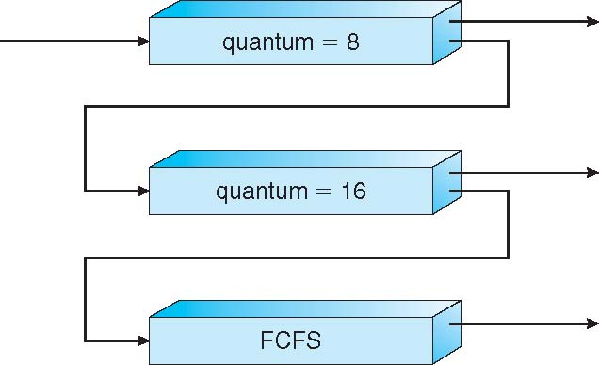
Multilevel Feedback Queues

Slide 24
Guaranteed (Fair-share) Scheduling
To achieve guaranteed 1/n of cpu time (for n processes/users logged on):
Monitor the total amount of CPU time per process and the total logged on time
Calculate the ratio of allocated cpu time to the amount of CPU time each process is entitled to
Run the process with the lowest ratio
Switch to another process when the ratio of the running process has passed its “goal ratio”

Slide 25
Guaranteed scheduling example
0
Process 1
Process 2
Process 3

Slide 26
Guaranteed scheduling example
1
Process 1
Process 2
Process 3

Slide 27
Guaranteed scheduling example
2
Process 1
Process 2
Process 3

Slide 28
Guaranteed scheduling example
3
Process 1
Process 2
Process 3

Slide 29
Guaranteed scheduling example
4
Process 1
Process 2
Process 3

Slide 30
Guaranteed scheduling example
5
Process 1
Process 3

Slide 31
Guaranteed scheduling example
6
Process 1
Process 2
Process 3

Slide 32
Guaranteed scheduling example
7
Process 1
Process 2
Process 3

Slide 33
Guaranteed scheduling example
8
Process 1
Process 2
Process 3

Slide 34
Guaranteed scheduling example
9
Process 1
Process 2
Process 3

Slide 35
Highest Response Ratio Next (HRRN)
Choose next process with the highest ratio of:
Similar to non-preemptive SJF but avoids starvation
time spent waiting + expected service time
expected service time

Slide 36
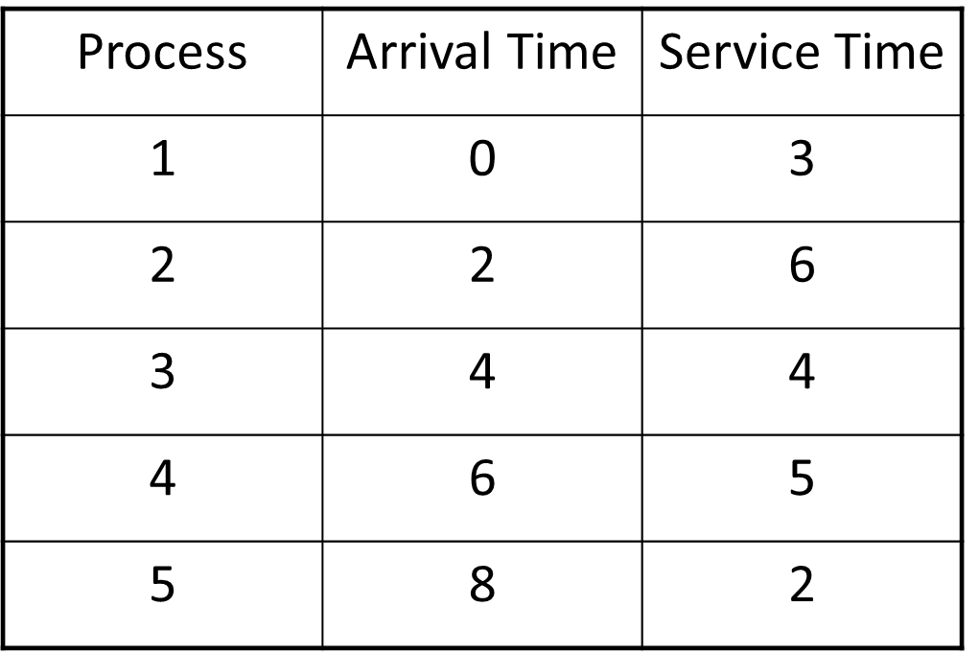
Exercise
Gantt Chart, AWT, ATAT ?

Slide 37
Any Question ?
Anything to discuss ?

